Slide 1

IoT
(Internet Of Things)

Slide 2
Few FAQ’S on IoT
What is IoT?
How does the IoT (Internet of Things) affect our everyday lives?
What are the benefits of IoT?
What are the different types of components used in IoT?
What is the most common IoT architecture?
List out some IoT Development Boards
What is the basic difference between an IoT device and a normal sensor device?
What is the full form of IIoT?
What is the full form of IoMT?
What is the full form of IoV?
What are the different types of communication models used in IoT?
What are the different types of sensors used in IoT?
What industries can be benefitted from IoT?
Use of Embedded Systems in IoT?

Slide 3
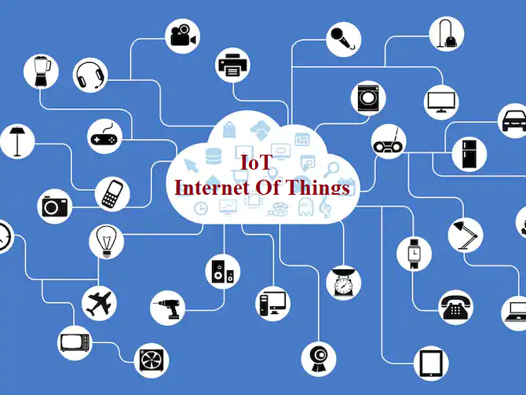
What is IoT?

Slide 4
"The Internet of Things (IoT) is a network of physical objects that contain embedded technology to communicate and sense or interact with their internal states or the external environment."
- International Telecommunication Union, ITU

Slide 5
"The Internet of Things (IoT) refers to the concept of connecting various devices to the internet and enabling them to communicate with each other and share data.“
- OpenAI

Slide 6
"The Internet of Things (IoT) is a paradigm shift that describes the interconnectivity of everyday objects, enabling them to send and receive data and be remotely monitored and controlled."
- IBM

Slide 7
"IoT is a system of interrelated computing devices, mechanical and digital machines, objects, animals, or people that are provided with unique identifiers and the ability to transfer data over a network without requiring human-to-human or human-to-computer interaction."
- Wikipedia

Slide 8
The Internet of Things (IoT) describes the network of physical objects—“things”—that are embedded with sensors, software, and other technologies for the purpose of connecting and exchanging data with other devices and systems over the internet.

Slide 9
How does the IoT (Internet of Things) affect our everyday lives?

Slide 10
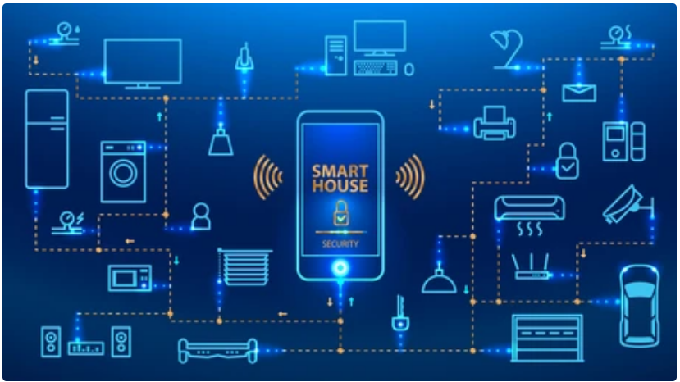
Here are some ways in which the IoT affects our everyday lives:
Smart Homes: IoT enables the concept of smart homes, where various devices and appliances are interconnected and can be controlled remotely. We can use voice commands or mobile applications to control lighting, thermostats, security systems, entertainment devices, and more. This automation and remote control enhance convenience, energy efficiency, and home security.

Slide 11
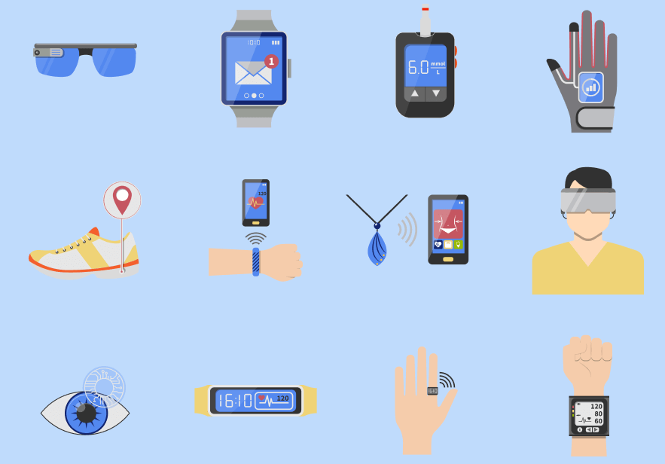
Wearable Devices: IoT powers wearable devices such as smartwatches, fitness trackers, and health monitors. These devices collect data about our physical activity, heart rate, sleep patterns, and more. With IoT connectivity, this data can be analyzed and used to monitor our health, track fitness goals, and provide personalized recommendations.

Slide 12
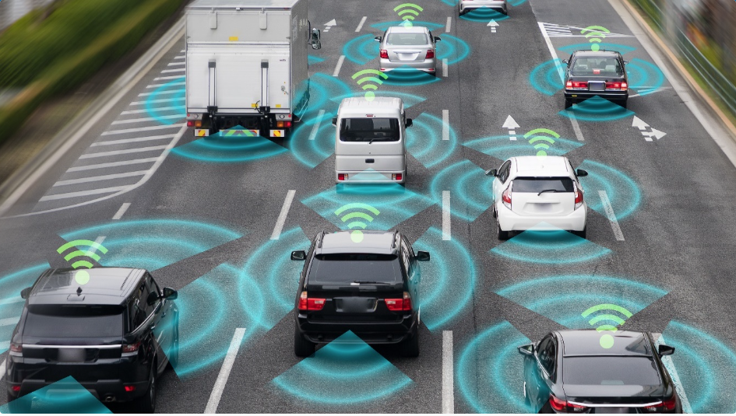
Transportation and Mobility: IoT is revolutionizing transportation and mobility. Connected cars can communicate with each other and infrastructure to optimize traffic flow, reduce accidents, and enhance navigation. IoT-enabled public transportation systems provide real-time updates on schedules and routes, improving commuting experiences. Additionally, ride-sharing platforms and electric vehicle charging networks rely on IoT connectivity.

Slide 13
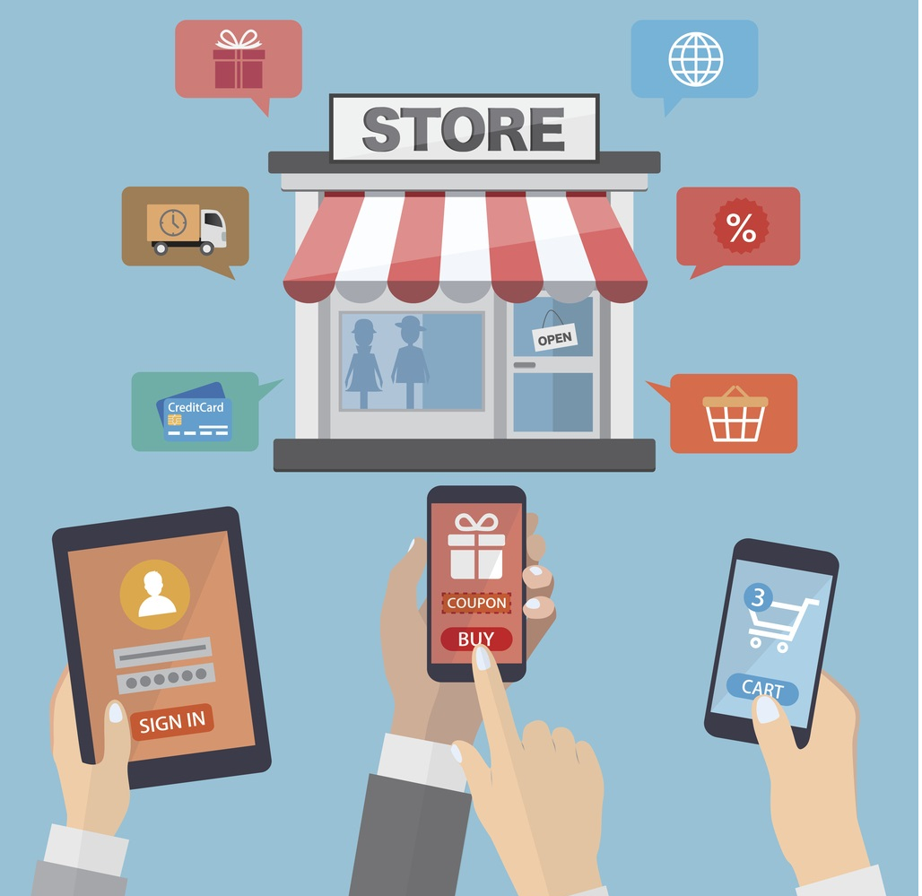
Personalized Shopping: IoT enhances the shopping experience by enabling personalized recommendations and targeted advertising. Retailers can use IoT data to understand customer preferences, track inventory levels, and offer customized promotions. Smart shelves and digital signage in stores can dynamically display information and engage shoppers.

Slide 14
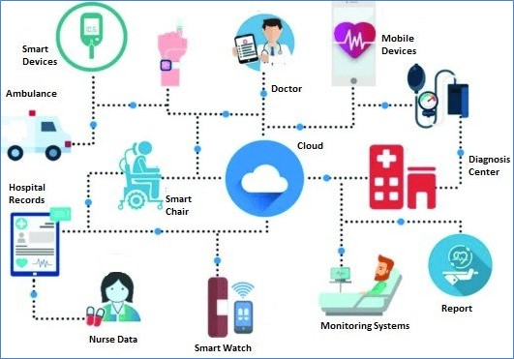
Healthcare and Remote Monitoring: IoT has a significant impact on healthcare. Remote patient monitoring devices enable healthcare providers to monitor patients' vital signs, medication adherence, and overall well-being from a distance. This allows for proactive care, timely interventions, and reduced hospital visits. IoT also supports telemedicine, enabling virtual consultations and remote diagnosis.

Slide 15
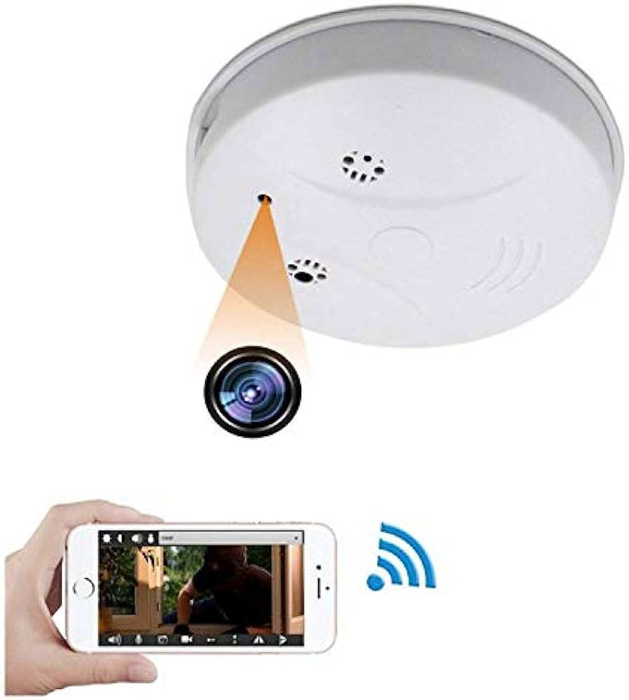
Safety and Security: IoT enhances safety and security in various ways. Connected security systems, video surveillance, and smart locks provide remote monitoring and control of our homes and offices. IoT-enabled fire alarms and carbon monoxide detectors can quickly detect and alert us to potential dangers.

Slide 16
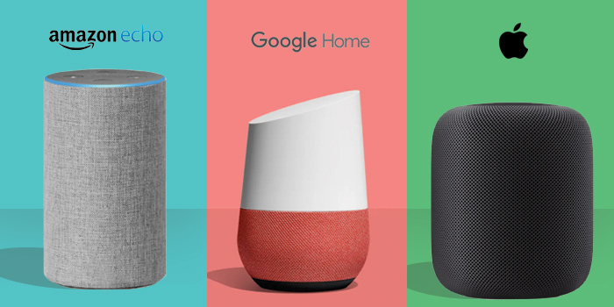
Personal Assistants and Voice Control: IoT powers voice-activated personal assistants like Amazon Alexa, Google Assistant, and Apple Siri. These assistants respond to voice commands, allowing us to control devices, access information, set reminders, and perform tasks hands-free.

Slide 17
Like so many ways IoT has been involving in our daily life.

Slide 18
What are the benefits of IoT?

Slide 19
benefits of IoT
IoT offers a wide range of benefits across various sectors and applications.
Here we will discuss some benefits of IoT

Slide 20
benefits of IoT
Improved Efficiency and Productivity: IoT enables automation, remote monitoring, and real-time data analysis, leading to increased efficiency and productivity. By connecting devices and systems, IoT streamlines processes, reduces manual intervention, and optimizes resource utilization.
Cost Savings: IoT can help organizations reduce costs in several ways. By monitoring and analyzing data, organizations can identify inefficiencies, minimize waste, and optimize energy consumption. Predictive maintenance enabled by IoT can prevent equipment failures and reduce downtime, resulting in cost savings.

Slide 21
benefits of IoT
Enhanced Decision-Making: IoT generates vast amounts of data that can be analyzed to gain valuable insights. Real-time data collection and analysis enable informed decision-making, allowing organizations to respond quickly to changing conditions and make data-driven strategic choices.
Improved Customer Experience: IoT enables the creation of personalized and connected experiences for customers. Smart devices and sensors can collect data about customer preferences, behavior, and usage patterns. This data can be utilized to deliver customized products, services, and recommendations, enhancing customer satisfaction and loyalty.

Slide 22
benefits of IoT
Safety and Security: IoT plays a crucial role in enhancing safety and security across various domains. Connected surveillance systems, smart home security devices, and industrial monitoring systems can detect threats, monitor critical parameters, and alert stakeholders in real time, enabling timely action and mitigating risks.
Healthcare and Well-being: IoT has significant applications in healthcare, enabling remote patient monitoring, wearable health devices, and smart healthcare systems. IoT can improve patient care, enhance health monitoring, and enable timely interventions, leading to better health outcomes.

Slide 23
benefits of IoT
Enhanced Connectivity and Communication: IoT facilitates seamless connectivity and communication between devices, systems, and people. This connectivity enables efficient collaboration, remote control, and remote access to data and devices, enhancing communication and enabling new services and applications.
Innovation and New Business Opportunities: IoT fosters innovation and creates new business opportunities. By leveraging IoT technologies and data, organizations can develop new products, services, and business models. IoT enables the creation of smart cities, connected transportation systems, smart homes, and various other innovative applications.

Slide 24
What are the different types of components used in IoT?

Slide 25
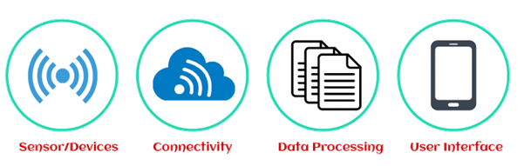
components used in IoT

Slide 26
components used in IoT
Sensors: Sensors are the most important part of IoT devices. In IoT devices, a sensor is used as an input device to gather live data from the surrounding environment. It can gather different types of data. For example, your phone has a temperature sensor, a GPS, an accelerometer, or a live video feature on a social media platform. Sensors make it possible for IoT devices to connect to the real world and outside the environment. This is all possible because of sensors.
Connectivity Mediums: After gathering data from the sensors, all data is sent to a cloud infrastructure. This is possible because of connecting the sensors to the cloud using a variety of communication mediums such as mobile or satellite networks, Bluetooth, WI-FI, WAN, etc. There are various types of IoT devices, and they use different types of connectivity mediums for communication.

Slide 27
components used in IoT
Data Processing: Data Processing: The data processing compound comes into play when the data has been collected and has reached the cloud. Now, it is the responsibility of the data processors to process the data for further use. Data processing software is required to enhance IoT devices in several ways. For example, it can adjust the air conditioner's temperature or recognize the faces on mobile phones and so on.
User Interface: The IoT devices require a user interface to interact with a user. A user interface is the visible, tangible component of an IoT system that users can access. It makes the information presentable and valuable for the end-user. A well-designed user interface can enrich the experience for users and encourage them to interact more. It makes the information easy and accessible to end-users, like sending alerts via notification, email, or text message.

Slide 28
What is the most common IoT architecture?

Slide 29
IoT Architecture
There is no single and general agreement about the architecture of IoT that is agreed on by the whole world and researchers. Many and different architectures have been proposed by researchers.
According to some researchers, IoT architecture has three layers, but some researchers support the four-layer architecture. They think that, due to enhancement in IoT, the architecture of three layers cannot fulfill the requirements of applications.
Due to a challenge in IoT regarding security and privacy, the architecture of five layers has also been proposed. It is considered that a recently proposed architecture can fulfill the requirements of IoT regarding security and privacy.

Slide 30
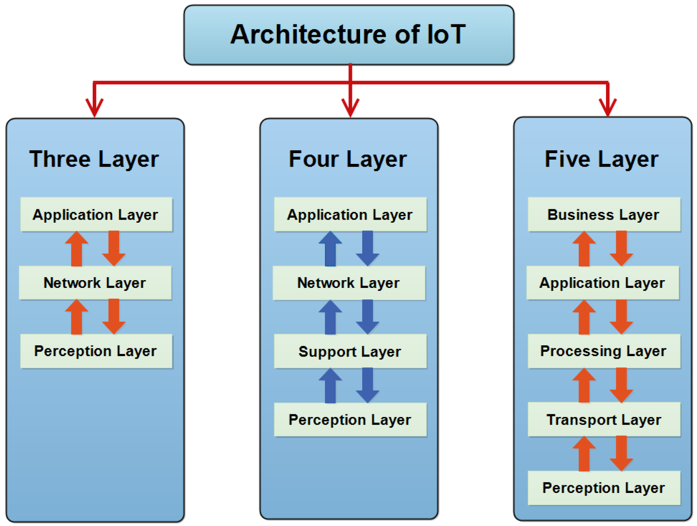
IoT Architecture

Slide 31
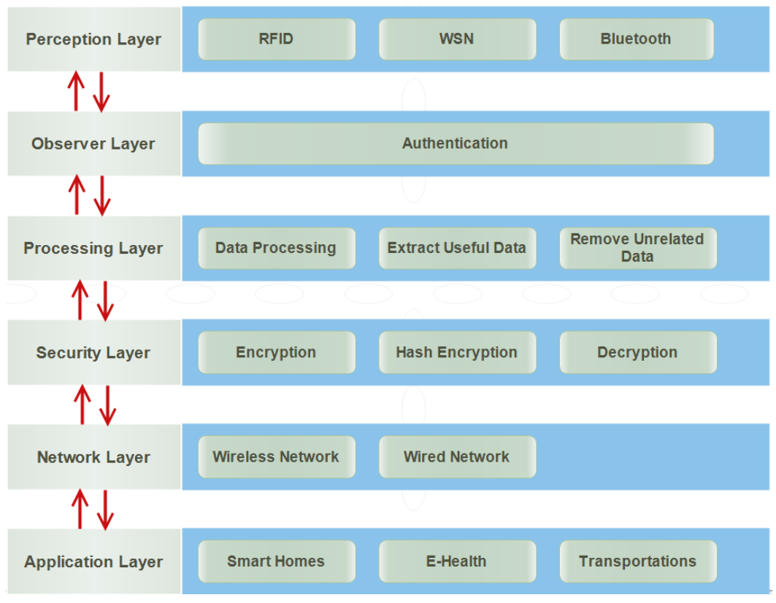
IoT Architecture
Improved Layered Architecture of IoT

Slide 32
IoT Architecture
Perception Layer:
It is also known as a sensor layer or physical layer.
It acts like five organs of IoT. It identifies objects in order to gather information.
For this purpose, different types of sensors are attached to the objects such Radio Frequency Identification (RFID) tags, barcode, Bluetooth, wireless sensors, LTE, etc.
A sensor is chosen according to the needs of users and objects where it is attached. It sends collected information to the observer layer to check the authentication of these sensors and devices.

Slide 33
IoT Architecture
Observer Layer:
The observer layer is also known as a monitor layer. The perception layer sends information to the observer layer. It checks information about whether it is protected from intruders and viruses or not.
If there is any attack, it does not pass information to the next layer for further processing. It only passes that information that is protected from intruders and viruses.
Furthermore, it also checks authentication of the objects. There are many ways to prove the identity such as authentication.

Slide 34
IoT Architecture
Processing Layer:
It collects information from the observer layer. It trusts that the information provided by the observer layer is protected from every type of attack. This layer is designed to eliminate unnecessary information.
It stores, analyzes and processes a huge amount of information that comes from the observer layer. It uses various technologies to extract useful information such as databases, cloud computing and data processing modules. The reason of removing unnecessary information is to save the network from heavy traffic. It also saves storage devices so that they cannot cross their limits.

Slide 35
IoT Architecture
Security Layer:
There are many proposed architectures of IoT, but they do not have a layer regarding security. It is designed to make the architecture of IoT secure.
There are many attacks on the network layer trying to get information from the users. Therefore, it makes secure information before sending to the network layer.
It receives information from the processing layer. It performs encryption through converting all information collected from the processing layer into unknown form, called cipher text.
The process of encryption is performed by using keys. It sends encrypted information to the network so that could not be understood by anyone other than the authentic users. It also sends a key to the receiver to convert the cipher text into original text. Thus, this layer protects the information of users from the attackers and risks existing on the network layer.
There are many ways to encrypt and decrypt the information such as Advanced Encryption System (AES) and Data Encryption System (DES).

Slide 36
IoT Architecture
Network Layer:
Network layer is also known as transmission layer.
The role of it is to connect all things together and permit the sharing of information to other connected things.
It receives information from the security layer in the form of cipher text. The reason for receiving information in cipher text is to protect from attackers and risks.
The medium of transmission can be both wireless media and wired. The medium is selected according to the needs of users and also communication technologies.

Slide 37
IoT Architecture
Application Layer:
Application layer is the last layer of the newly proposed layered architecture.
It is responsible for data formatting and presentation
.
It is also responsible for delivery of numerous applications to different users.
It defines several applications in which IoT can be used, such as smart home, smart transport, smart cities, smart health, animals and agriculture.
It has a responsibility for providing the application specific service to the users.
The service is chosen according to the information that is collected by the sensors from objects

Slide 38
List out some IoT Development Boards

Slide 39
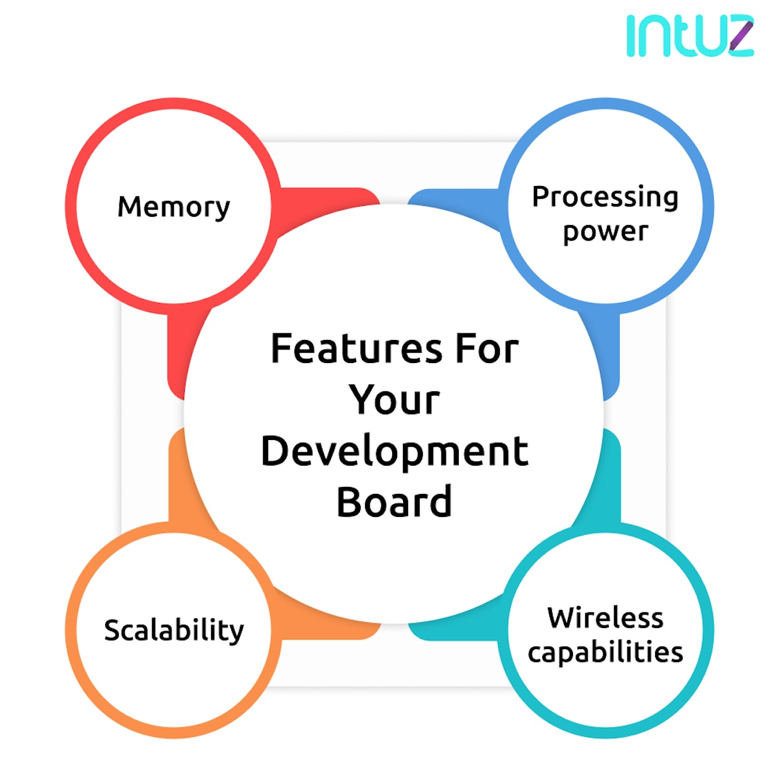
IoT Development Boards
Any development board you consider for an IoT project must include a few important features. Those are:

Slide 40
IoT Development Boards
Processing power. This could be in the form of a CPU, microcontroller, FPGA (Field Programmable Gate Array), or other CPLD (Complex Programmable Logic Device). A microcontroller comes in handy for programming your device as many manufacturers provide the IDE you need.
Wireless capabilities. This feature provides wireless communication without including an external transceiver module. Some of the common protocols include Bluetooth, Zigbee, WiFi, and others.
Scalability. This particular feature allows one to add more functionality to the development board? You may verify if the board communicates via GPIO, UART, SPI, or some other protocol; As this will determine how the board interacts with other devices.
Memory. Board memory is important. To store much data, you need built-in Flash memory. A decent board allows connecting a MiniSD or MicroSD card to enhance data storage.

Slide 41
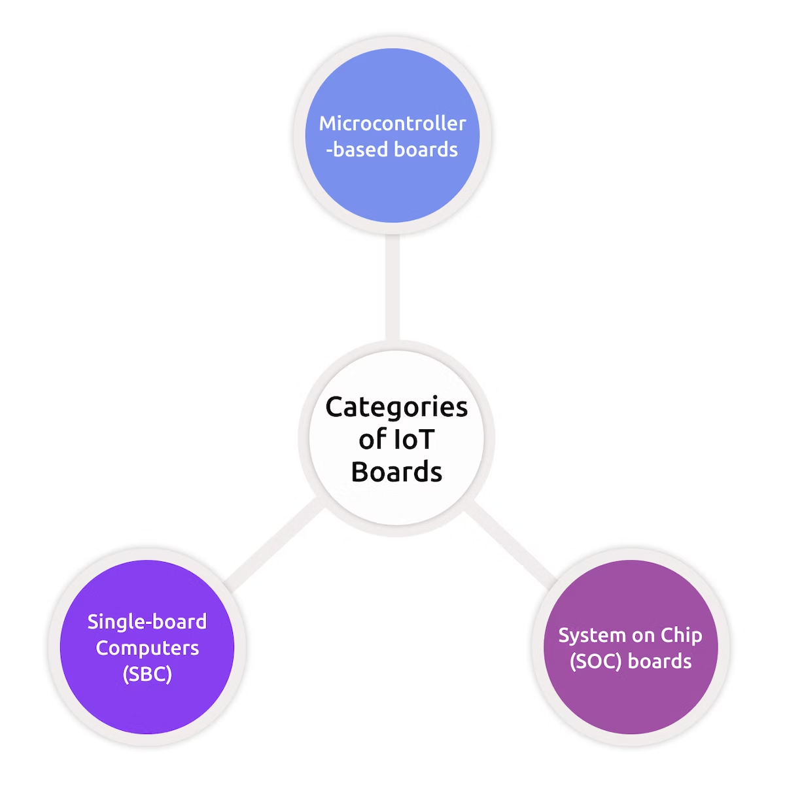
IoT Development Boards
IoT board are categorized into three types. Those are

Slide 42
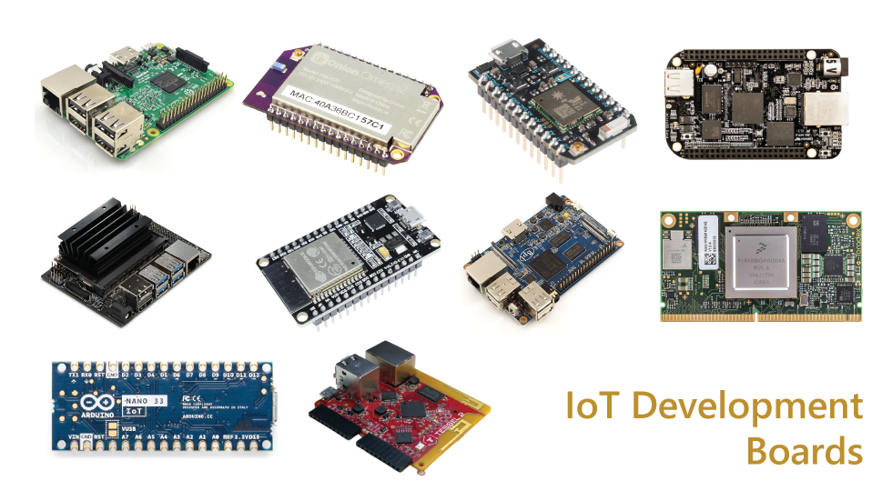
IoT Development Boards

Slide 43
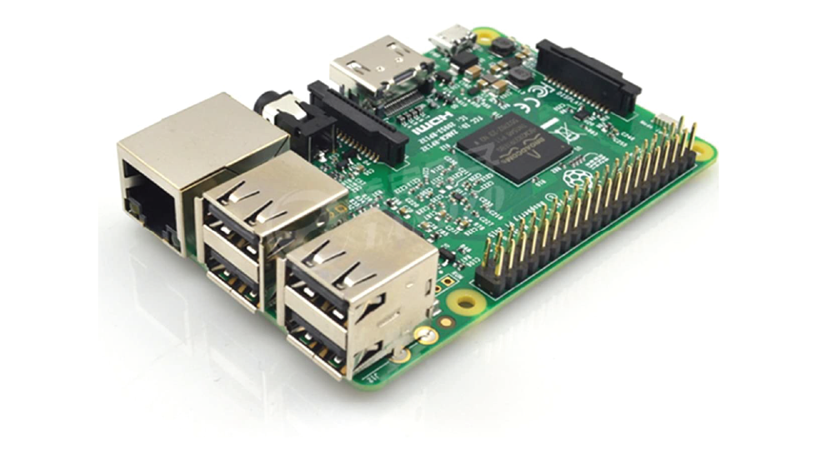
IoT Development Boards
The raspberry pi Development Board is a small credit card size computer. That works on Linux based operating systems and is good for embedded projects. Raspberry boards can be easily plugged in to your monitor, computer or TV. It uses a standard keyboard and mouse. Even amateur users depend on it for configuring their digital media systems and surveillance cameras.
Features :
Processor: 1.2GHz, 64-bit quad-core ARMv8 CPU
802.11n Wireless LAN
Bluetooth 4.1
Bluetooth Low Energy (BLE)
1GB RAM
4 USB ports
40 GPIO pins
Full HDMI port
Combined 3.5mm audio jack and composite video
Camera interface (CSI)
Display interface (DSI)
Micro SD card slot
videoCore IV 3D graphics core
Raspberry Pi

Slide 44
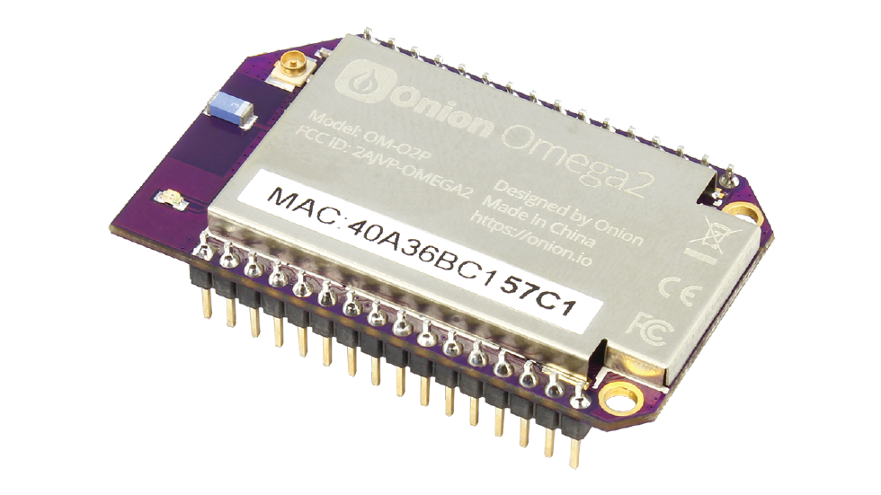
IoT Development Boards
Omega 2 is one of Onion’s Linux-based WiFi development boards that allow makers of all skill levels to build connected hardware. This highly integrated board comes with a powerful processor and flexible GPIOs. The Platform lets you prototype hardware devices using familiar tools like Git, npm, pip, as well as high-level programming languages like Python, Javascript, and PHP.
Features :
Linux Operating System, powerful processor, and flexible GPIOs.
Compact size that easily fits into any project design.
Modular design for a vast range of flexibility.
Arduino compatible.
Integrated Wi-Fi;
Connectivity is expandable with 2G, 3G, Ethernet, Bluetooth®, Bluetooth Low Energy (BLE), GPS.
U.FL Connector for external Wi-Fi antenna attachment.
FCC and CE Certified.
Omega 2

Slide 45
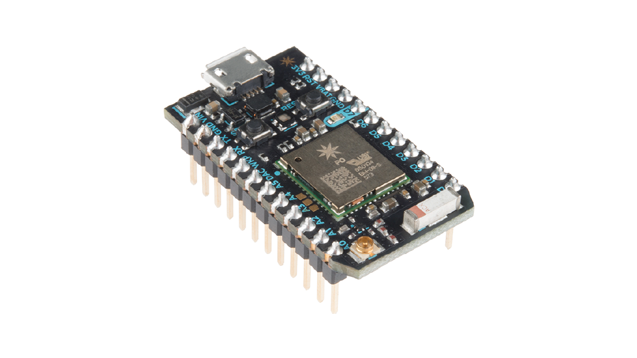
IoT Development Boards
Particle Photon Board consists of an STM32 microcontroller, Wi-Fi, Switches, and LEDs. Simple to use, powerful, and connected to the cloud. Powered by a Cypress Wi-Fi chip alongside a powerful STM32 ARM Cortex M3 microcontroller, it is ideal for prototyping IoT projects.
Features :
Processor: STM32F205 120Mhz ARM Cortex M3
Real-time operating system (Free RTOS)
Memory: 1MB flash, 128KB RAM
Open source design
On-board Wi-Fi module
On-board RGB status LED.
18 Mixed-signal GPIO and advanced peripherals
Soft AP setup
B802.11b/g/n Wi-Fi
roadcom BCM43362 Wi-Fi chip
Particle Photon

Slide 46
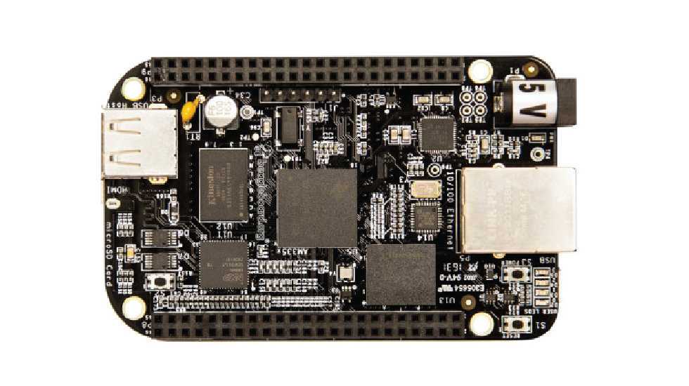
IoT Development Boards
The Beagle bone is a low power open-source single-board computer produced by Texas instruments. The board can boot Linux in under 10 seconds also you can start developing in less than 5 minutes with just a single USB cable.
It is a computer installed inside of a larger electronics project. The beagle board carries two rows of GPIO (general purpose Input/Output) pins mounted along each side of the board. That allow it to communicate with a wide range of servos, sensors, outputs and other hardware, making it act as the brain of large & complex projects.
Its capabilities can be extended using plug-in boards referred to as “capes”. that are easily available for LCD, motor control, VGA, prototyping, battery power, and other functionalities.
Features :
DDR memory: 512 MB
Ability to run Ruby, Python, and INO Sketches directly in the Cloud9 IDE,
Ethernet: On-chip 10/100 Ethernet
JTAG: Optional
Memory: 4GB eMMC memory
Power Options: Via USB or 5V DC input
Price (USD) Per Unit: $55.00 (Suggested Retail Price)
Processor: 1GHz AM3359 Sitara ARM Cortex-A8
Beagle Bone

Slide 47
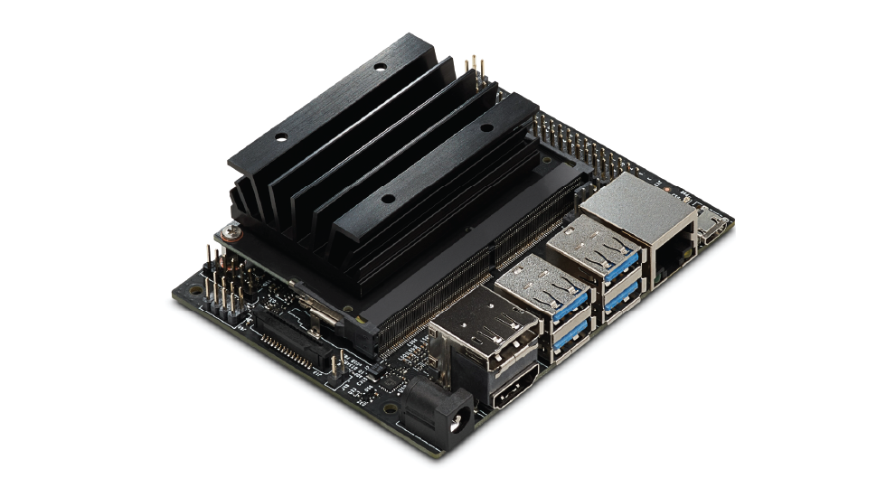
IoT Development Boards
Jetson Nano is a power-efficient and low-cost development board. Provides total performance to run modern AI workloads in a small form factor. Additionally, It has the ability for heavy workload applications like image classification, object detection, segmentation, and speech processing. It is capable to run multiple neural network apps at the same time.
Features:
GPU: 128-core NVIDIA Maxwell™ architecture-based GPU.
CPU: Quad-core ARM® A57.
Video: 4K @ 30 fps
Camera: 1/3″ AR0330 CMOS Image sensor with 2.2 µm pixel.
Memory: 4 GB 64-bit LPDDR4; 25.6 gigabytes/second.
Connectivity: Gigabit Ethernet.
OS Support: Linux for Tegra®.
Jetson Nano

Slide 48
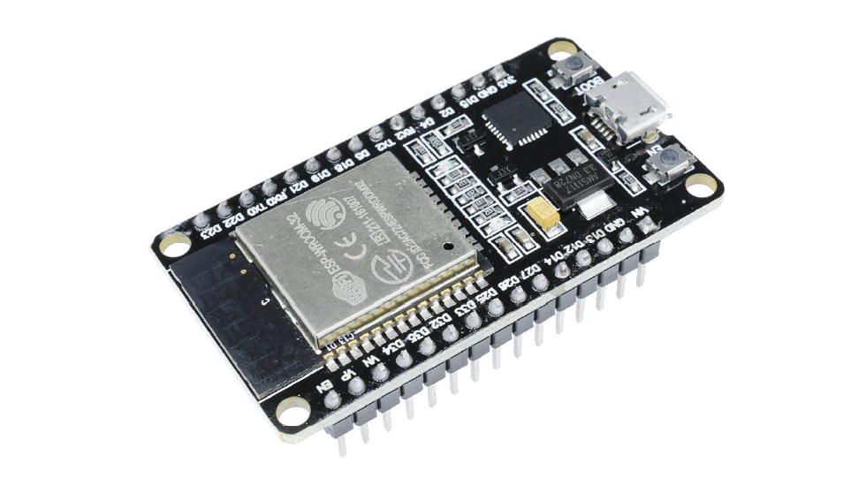
IoT Development Boards
ESP32 is a dual core low-footprint system development board powered by the latest ESP-WROOM-32 module that can be easily placed into a solderless breadboard. It has a pre-integrated antenna, power amplifier, low-noise amplifiers, filters, and power management module. Because of this, it’s easy to build and test circuits as well as making projects related to IoT integrating with the cloud platform.
Features :
2.4 GHz dual-mode Wi-Fi.
Programmable with Arduino open-source IDE.
8 independent LED.
Bluetooth chips by TSMC.
40nm low power technology, power, and RF.
Easily embedded with other products.
Strong function with support LWIP protocol.
Supports three modes: AP, STA, and AP+STA.
Supporting the Lua program, easily to develop.
ESP 32

Slide 49
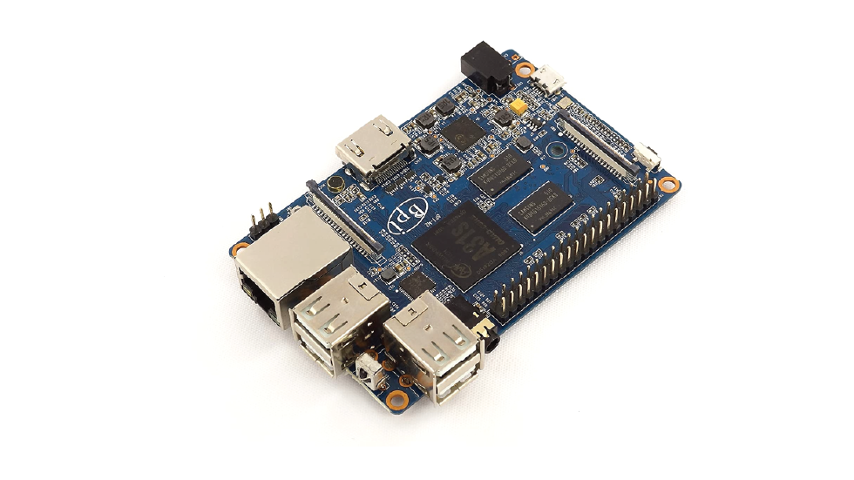
IoT Development Boards
Banana Pi is a line of low-cost credit card-sized single-board computers(SBC). IT is a router-based development board, which efficiently runs on various open-source operating systems including OpenWRT and Android, Lubuntu, Ubuntu, Debian, and Raspbian. Well, the hardware design of banana pi was influenced by the Raspberry Pi and it is compatible with Raspberry Pi boards.
Features :
All winner A20 Dual-core 1.0 GHz CPU
Mali-400 MP2 with Open GL ES 2.0/1.1.
1 GB DDR3 memory.
1x Gigabit LAN
1x SATA interface.
1X MIC
1x USB otg and 2x USB 2.0
HDMI out
Composite video out
CSI camera interface
DSI display interface
26 PIN GPIO
Banana Pi

Slide 50
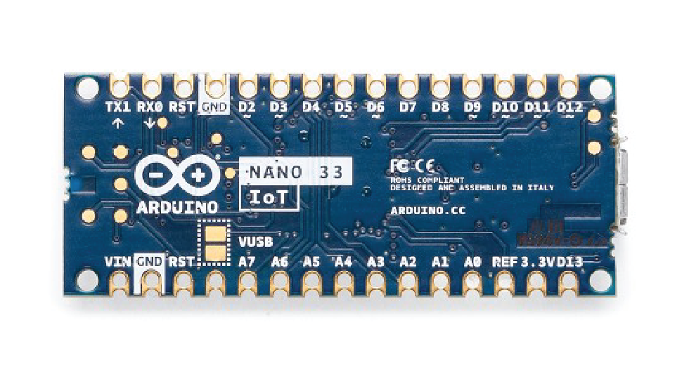
IoT Development Boards
The Arduino Nano 33 IoT is a dual-processor device that is perfect for experimentation. It offers a practical and low-cost solution for inventors seeking to add Wi-Fi connectivity to their projects with minimal previous experience in networking. The board is compatible with the Arduino IoT Cloud, where you can create IoT applications in a few simple steps
Features :
ARM Cortex-M0 32-bit SAMD21 processor
14 digital I/O pins and 8 analog input pins
Support up to 12-bit ADC/PWM and 10-bit DAC resolutions.
Can operate as a few different USB devices: (asynchronous serial, keyboard or mouse) also referred as HID, and USB MIDI.
Can communicate via Synchronous serial communications.
Inbuilt real-time clock module.
Arduino Nano 33 IoT

Slide 51
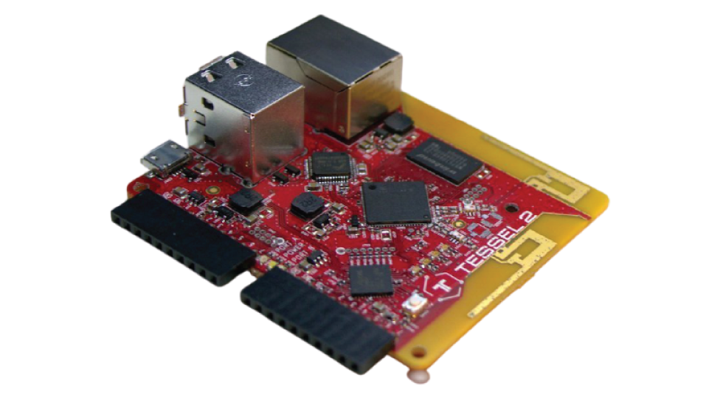
IoT Development Boards
It’s a kind of System on Chipboards. With WIFI capabilities, it allows you to build scripts in Node.js. The board also provides you with a connected hardware prototyping system that can be used in multiple different applications. Loaded with on-board features including two 10-pin module ports to add sensors and other external hardware, a 10/100 supported ethernet port, 2 USB ports for camera peripherals and flash storage, and a microUSB connector for power and tethered programming.
Features :
2 USB ports (you can connect cameras or flash storage, for example)
10/100 ethernet port
802.11 b/g/n WiFi
580MHz Mediatek router-on-a-chip (you can turn your Tessel 2 into an access point!)
48MHz SAMD21 coprocessor (for making I/O faster)
64MB DDR2 RAM, 32MB of flash (lots of space for your programs and stuff)
Tessel 2

Slide 52
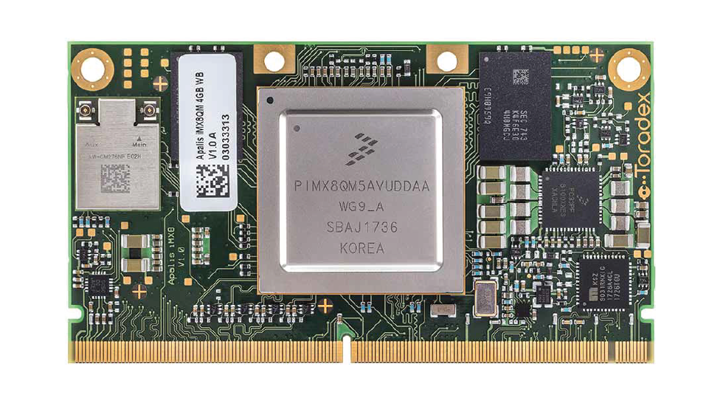
IoT Development Boards
i.MX 8 boards offer low power, flexible memory options, a wide range of high-speed interfaces, as well as industry-leading audio and video capabilities. It also comes with a pre-installed boot image flashed on one eMMC memory.
With best-in-class computing power, superior graphics performance, and sophisticated security features, i.MX boards became the next-gen technology for industrial embedded systems.
Features :
i.MX 8M Quad Applications Processor.
4x Arm Cortex-A53 @ 1.5GHz.
NXP PMIC PF4210 power management.
LPDDR4 x32 @3200MT w/4GB, eMMC 5.0 w/16GB, MicroSD, QSPI w/256Gb memory availability.
HDMI 2.0a Type-A , MIPI-CSI Camera mini-SAS, MIPI-DSI Display mini-SAS camera connector.
10/100/1000 Ethernet, USB 3.0 Type-A & C, PCIe M.2 interface, and Infrared connector.
Linux, Android, and FreeRTOS OS support.
i.MX 8

Slide 53
What is the basic difference between an IoT device and a normal sensor device?

Slide 54
A normal sensor device does not need an active internet connection to work properly. On the other hand, IoT devices always require an active internet connection to work properly.

Slide 55
What is the full form of IIoT?
What is the full form of IoMT?
What is the full form of IoV?

Slide 56
Industrial internet of Things
Internet of Medical Things
Internet of Vehicles

Slide 57
What are the different types of communication models used in IoT?

Slide 58
IoT communication models
IoT devices must be connected to the internet to work properly.
These devices connect and communicate through their technical communication models. There are several ways to connect them to the internet for communication.
An effective communication model is required for proper communication.
Following is a list of different types of communication models used in IoT:
  Request-Response Communication Model
  Publisher-Subscriber Communication Model
  Push-Pull Communication Model
  Exclusive-Pair Model

Slide 59
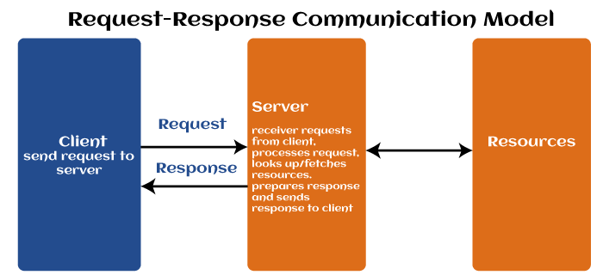
IoT communication models
Request-Response Communication Model:

Slide 60
IoT communication models
As the name specifies, the request-response communication model is based on the client making requests and the server responding to those requests.
When the server receives a request, it decides what response to be provided. It fetches the requested data, prepares the response, and then sends it back to the client.
This model does not retain the data between requests; therefore, each request is handled independently. That's why this is called a stateless model.

Slide 61
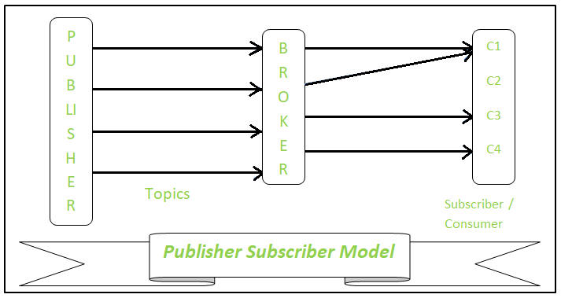
IoT communication models
Publisher-Subscriber Communication Model

Slide 62
IoT communication models
In this communication model, publishers, brokers, and consumers are all involved in communication.
Publishes are used as sources of data that send data to topics.
The broker manages the topics, and consumers subscribe to the topics.
Publishers and consumers are not directly related to each other.
When the publisher receives the data for a topic, the broker forwards it to all subscribed consumers. It means brokers are responsible for receiving data from publishers and sending it to the appropriate consumers.

Slide 63
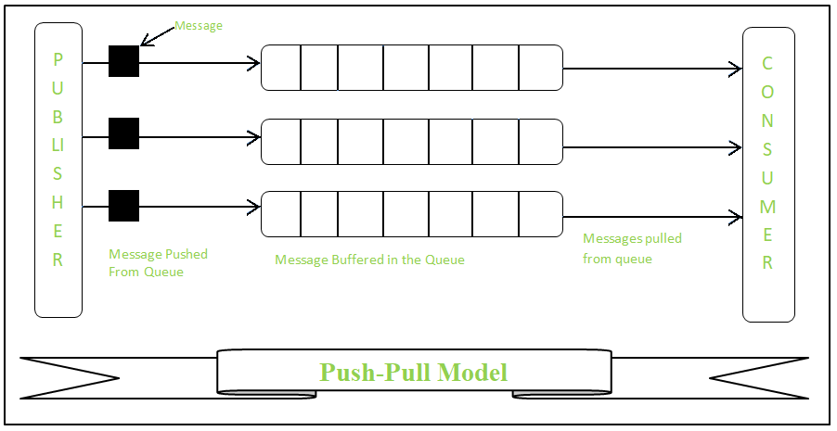
IoT communication models
Push-Pull Communication Model:

Slide 64
IoT communication models
The push-pull communication model ensures that data producers push the data into queues while consumers pull the data from the queues.
In this communication model, neither producer nor consumer knows about each other, and it is the responsibility of the queue to decouple the messages between the consumers and the producers.
Here, queues also act as a buffer if any mismatch is found between the rate at which producers push data and the rate at which consumers receive it.

Slide 65
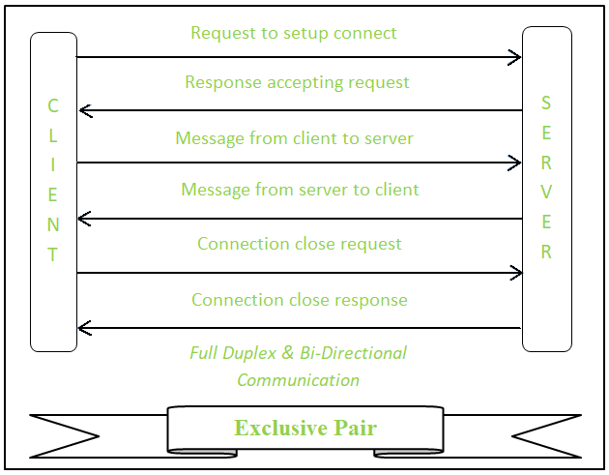
IoT communication models
Exclusive-Pair Model:

Slide 66
IoT communication models
This is the most efficient model for quick communication.
This is a full-duplex, bidirectional communication model developed for constant/continuous connections between a client and server.
Once a connection is established, the clients and the servers can send and receive messages.
As long as a client doesn't send a request to close the connection, the connection remains open.
The server takes care of every open connection.

Slide 67
What are the different types of sensors used in IoT?

Slide 68
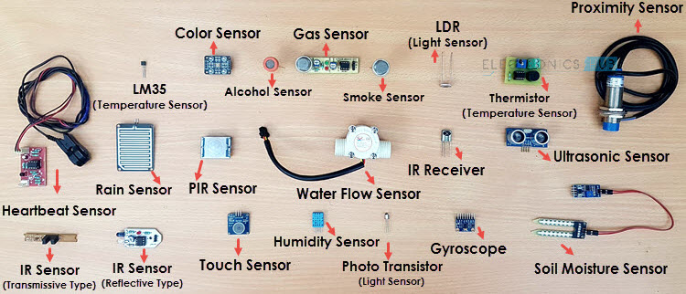
Sensors used in IoT

Slide 69
What industries can be benefitted from IoT?

Slide 70
A wide range of industries can be benefitted from IoT. Some of them are as follows:
Consumer devices
Healthcare
Agriculture
Manufacturing
Automation and public transportation
Utilities and energy
Smart cities and smart homes
And many more …..

Slide 71
ThingSpeak
What is ThingSpeak?
What are the different features of ThingSpeak?
What type of data is accepted by ThingSpeak?
Is ThingSpeak free?
How do you send/collect data from ThingSpeak?
ThingSpeak comes under which communication protocol?

